Slide 1


Lecture 8:
File I/O and Error Handling
CoTaPP: Computational Thinking and
Programming with Python
All icons by: https://www.flaticon.com/

Slide 2





Slide 3

Previous lecture
Data structures
  lists
  tuples
  dictionaries
  sets

Slide 4
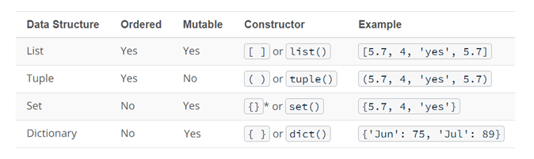
Previous lecture

Slide 5


Today’s lecture

Slide 6
Today’s lecture
string
int

Slide 7
Today’s lecture
string
int
for
while

Slide 8
Today’s lecture
string
int
for
data structures
while
functions
functions

Slide 9

Today’s lecture
string
int
for
data structures
while
functions
functions

Slide 10

Today’s lecture
string
int
for
data structures
while
functions
functions

Slide 11

Today’s lecture
string
int
for
data structures
while
functions
functions

Slide 12
Today’s lecture
DATA
INFORMATION

Slide 13
Today’s lecture
Reading and Writing Files
  textual files
CSV Files
  a Comma Separated Values (CSV) file is a plain text file that contains a list of data
Error Handling
  how to deal with missing/wrong data

Slide 14
Today’s lecture
Reading and Writing Files
  textual files
CSV Files
  a Comma Separated Values (CSV) file is a plain text file that contains a list of data
Error Handling
  how to deal with missing/wrong data

Slide 15
Today’s lecture
Reading and Writing Files
  textual files
CSV Files
  a Comma Separated Values (CSV) file is a plain text file that contains a list of data
Error Handling
  how to deal with missing/wrong data

Slide 16
Example
You want to analyze the average household income by municipality in NL

Slide 17
Example
You want to analyze the average household income by municipality in NL
Amsterdam 31400

Slide 18

Example
You want to analyze the average household income by municipality in NL
Amsterdam 31400
Amsterdam 31400
Delft 32100
Epe
Zeist 39700

Slide 19
Example
You want to analyze the average household income by municipality in NL
Amsterdam 31400
Amsterdam 31400
Delft 32100
Epe
Zeist 39700

Slide 20
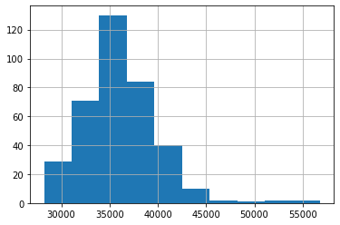
Example
You want to analyze the average household income by municipality in NL
Amsterdam 31400
Amsterdam 31400
Delft 32100
Epe
Zeist 39700

Slide 21




Slide 22
To Do
Exercises for the week
  Use quarterfall to submit them
Work in Project 2
Practice practice practice!
Ask questions!

Slide 23
Next lecture
Remote resources
  fetching data and other resources from the internet
  and how to interact with web services from within Python programs

